Slide 1
Legal Aspects for Pharmapreneurs
At
Parul Institute of Pharmacy & Research
December 28, 2019
By
Dr. Kalpeshkumar L Gupta
Associate Professor of Law & EDC Coordinator
Parul Institute of Law, Faculty of Law
Parul University, Vadodara
www.klgupta.in

Slide 2
Legal Aspects of Pharmapreneurs
Forms of Business
Sector Specific Laws/Rules
IPR
Other Laws
Labour, Tax, Competition Law, SEBI etc
Emerging Area
Online Sell of Medicine
klgupta.in

Slide 3
Form of Business
Sole Proprietorship
Partnership (Indian Partnership Act, 1932)
Limited Liability Partnership (Limited Liability Partnership Act, 2008
Company (Companies Act, 2013)
klgupta.in

Slide 4
Sector Specific Laws/Rules etc.
Drug & Cosmetics Act, 1940
Central Drug Standard Control Organization (CDSCO)
(Ministry of Health & Family Welfare)
Pharmacy Act, 1948
National Pharmaceuticals Pricing Authority (NPPA), 1997
Independent Regulator
(Dept. of Pharmaceuticals, Ministry of Chemicals & Fertilizer)
4. Narcotics, Drug & Psychotropic Substances Act, 1985
klgupta.in

Slide 5
Intellectual Property Rights (IPR)
1. Patent (Patent Act, 1970)
2. Trademark (Trademark Act, 1999)
3. Copyright (Copyright Act, 1957)
4. Design (Design Act, 2000)
5. Geographical Indication (Geographical Indications Act, 1999)
6. Protection of Plant Varieties and Farmers' Rights Act, 2001
7. Trade Secret
klgupta.in

Slide 6
Others Laws/Rules/Regulations
Labour & Industrial Laws
Taxation
Competition Law
SEBI
Local Laws
Other laws
klgupta.in

Slide 7
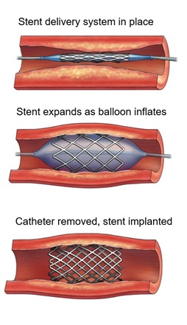
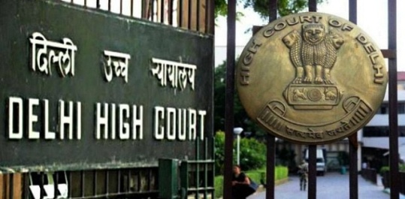
Emerging Issues
Rs. 3300 Cr. Coronary Stent Industry
30 Million people suffer cardiovascular
2 Million+ people die because of heart attack
2 Lakh heart surgery every year
klgupta.in

Slide 8
Emerging Issues
Lawyer with a heart: Birender Sangwan’s fight to cap price of coronary stents
Stent to be included in National List of Essential
Medicine (NLEM)
- Bare Metal Stent Rs. 45,000 to Rs. 7,260
Modern Drug Elutin Stent Rs. 1,20,000 to Rs. 29,600
klgupta.in

Slide 9
Online Medicines
Brand Name
Legal Name
Axelia Solution Pvt. Ltd. (2015)
Netmeds Marketplace Ltd. (2010)
Practo Technologies Pvt. Ltd. (2008)
1mg Technologies Pvt. Ltd. (2015)
klgupta.in

Slide 10
Online Medicines
klgupta.in

Slide 11
Emerging Issues
Snapdeal raided by Maharashtra Food & Drug Administration for selling prescription drug like Viagra online – April 2015
Viagra, Cough Syrum (Ascoril)
https://economictimes.indiatimes.com/industry/services/retail/snapdeal-raided-by-maharashtra-food-and-drug-administration-for-selling-prescription-drugs-like-viagra-online/articleshow/46959145.cms?from=mdr April 2015
klgupta.in

Slide 12
Emerging Issues
Union Health Ministry Draft Rules on Sale of Drugs by Online – E Pharmacy
August 28, 2018
klgupta.in

Slide 13
Startups
klgupta.in

Slide 14
States told to restrain unlicensed e-pharmacies
The Drug Controller General of India (DCGI) has asked the state-level drug regulators to ensure that e-pharmacies don’t sell medicines without a licence.
Last year, the Delhi High Court had issued an order barring entities without licences from selling medicines through online platforms. In a letter dated November 28, the DCGI has asked the state licensing authorities to implement this order strictly.
The order had been passed in response to a public interest litigation (PIL) filed by Delhi-based dermatologist Zaheer Ahmed, who said that absence of monitoring of online sale of medicines is a risk to both patients and doctors. The Drugs and Cosmetics Act, 1940, and Pharmacy Act, 1948 prohibited online sale of medicines.
https://economictimes.indiatimes.com/industry/healthcare/biotech/pharmaceuticals/states-told-to-restrain-unlicenced-e-pharmacies/articleshow/72358177.cms December 4, 2019
klgupta.in

Slide 15
My Story
2016
2017
klgupta.in
probono-india.in
2018
2019
legalstartups.info
courtmanagement.in
klgupta.in

Slide 16
Why startup succeed?
klgupta.in

Slide 17
Dr. Kalpeshkumar L Gupta
www.klgupta.in

